Slide 1
Discovering HTTPSified Phishing Websites Using the TLS Certificates Footprints
Shubham Kumar
M.Tech 2020IS-09

Slide 2
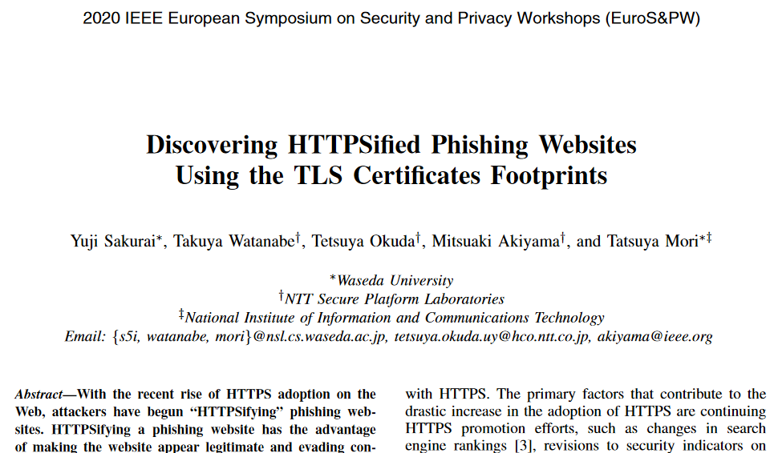
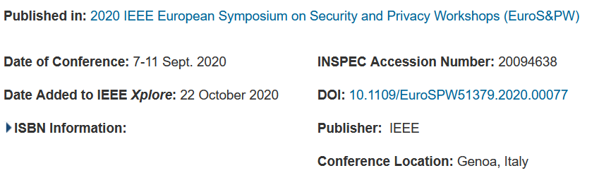
https://ieeexplore.ieee.org/document/9229674

Slide 3
Outline
Introduction
Background
Framework
Results
Discussion
Conclusion

Slide 4
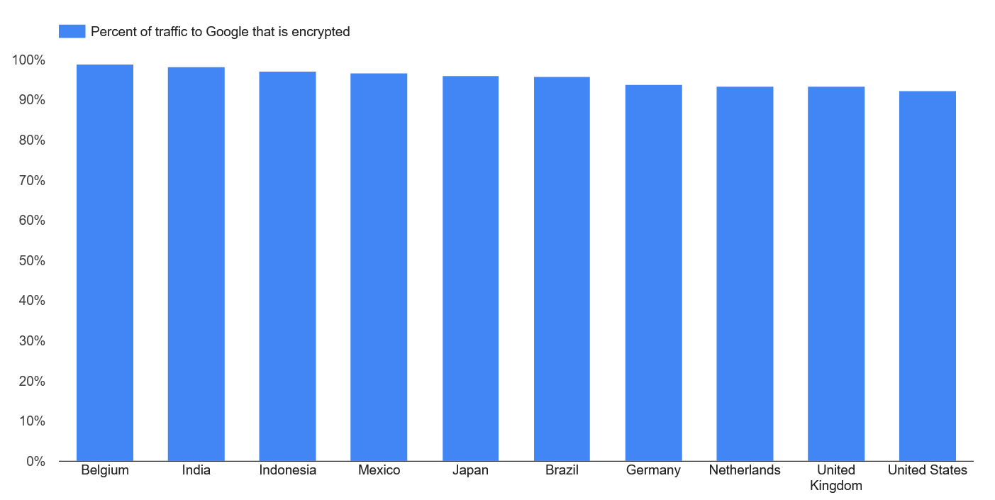
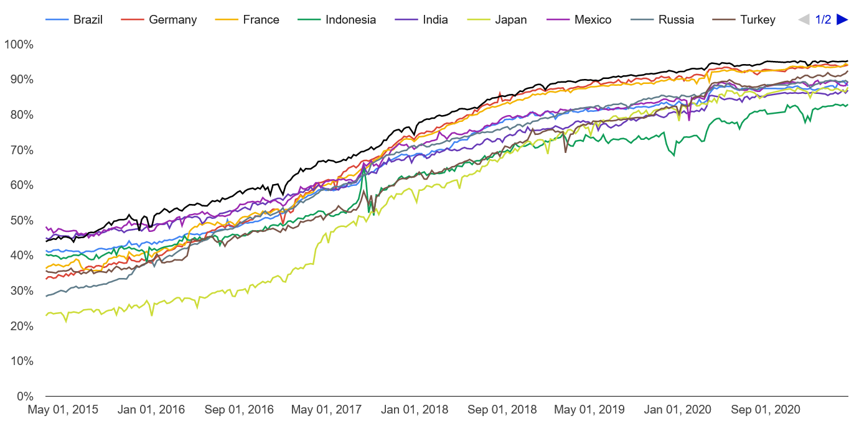
Introduction
Percentage of pages loaded over HTTPS in Chrome by country/region
The adoption of HTTPS on the Web has increased drastically over the past few years.
https://transparencyreport.google.com/https/overview?hl=en

Slide 5
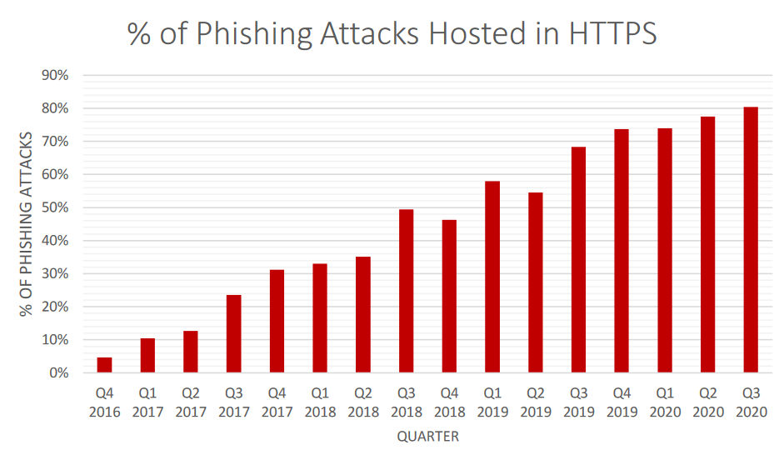
Why focus on certificates?
Increasing number of HTTPSified phishing websites
https://apwg.org/trendsreports/

Slide 6
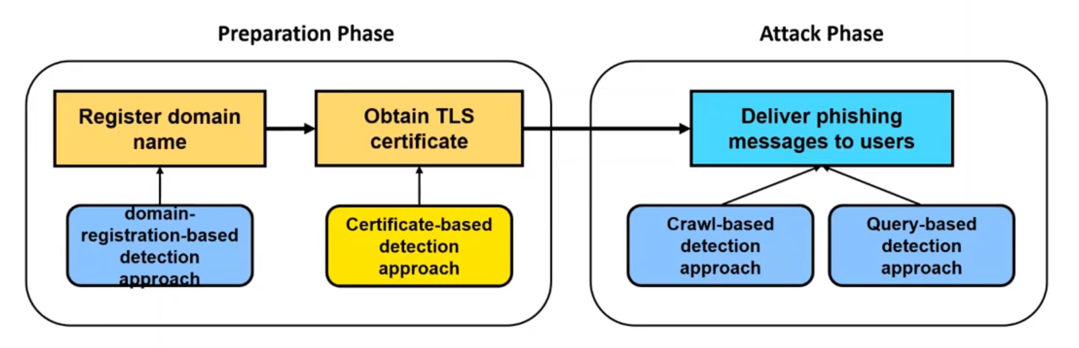
Phishing detection approach
Domain-registration-based detection approach fails to detect phishing websites if the attacker utilize DDNS or hosting service

Slide 7
Research Questions
Is there a way to detect phishing websites with the certificates?

Slide 8
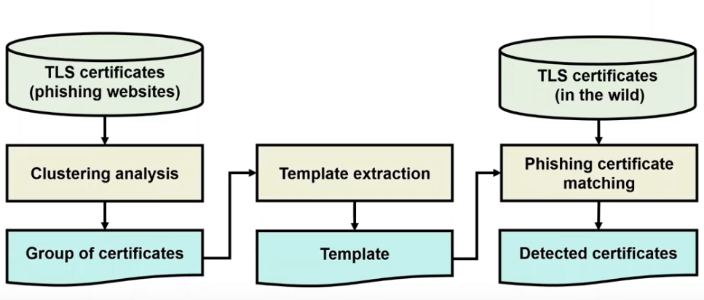
Overview of the Framework

Slide 9
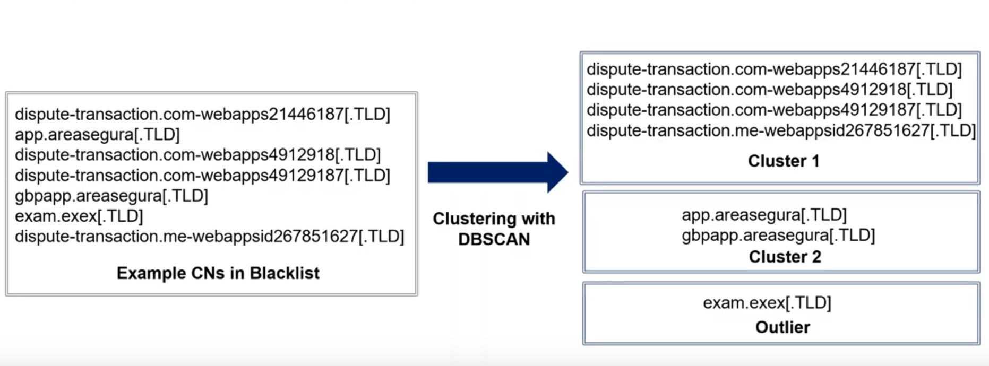
Clustering Example

Slide 10
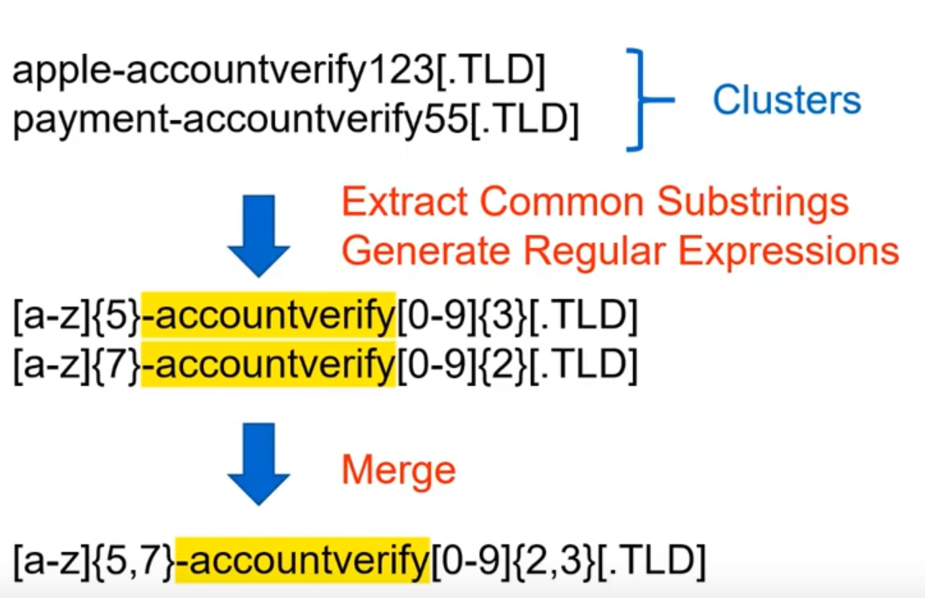
Template Extraction

Slide 11
Data Collection
Phishing certificates
- 1634 from OpenPhish and Censys
Templates
- 69 from the clusters
Certificates
- 38.7M from Let’s Encrypt and cPanel

Slide 12
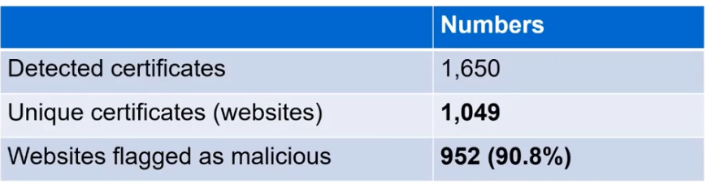
Detection Result
Of the detected certificates, 24.8% utilized DDNS or hosting services
The 1049 websites are previously unknown

Slide 13
Case Study
A template matched a large amount of certificates in the wild.
[a-z]{6,8}.runescape.com-[a-z]{1,8}[.TLD]
Template accounted for 56% of all detected certificates.
93% were issued by let’s encrypt
It offers following services
Mass mailer to send a lot of phishing emails
Logging
Analytics
Marketplace

Slide 14
Limitations
Bias inherent in dataset
Evaluating the phishing websites
Threats to validity

Slide 15
Conclusion
Certificate-based phishing-detection framework
Discovering previously unknown HTTPS-ified phishing websites.
Compensating for the shortcomings of the traditional methods.
Understanding the phishing infrastructure

Slide 16
References
https://ieeexplore.ieee.org/document/8418638
https://ieeexplore.ieee.org/document/5480600
https://transparencyreport.google.com/https/overview?hl=en
https://lookup.icann.org/lookup

